Slide 1
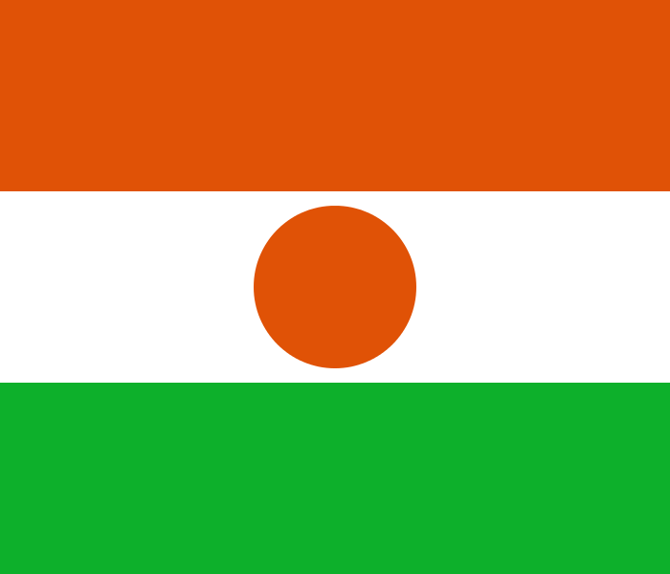
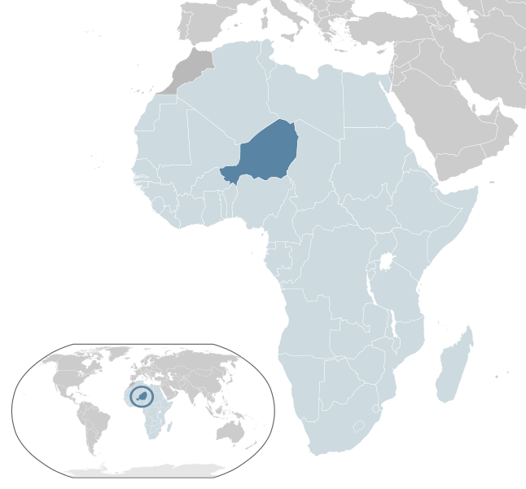
INTERNATIONAL TRADE
REPUBLIC OF NIGER
Capital: Niamey
Population (2013): 17 138 707
Area: 1 267 000
Government: Unitary Semi-presidential Republic
Case of niger
Mahamane Moutari ABDOU B.
20100401110

Slide 2
INTRODUCTION
International trade is the exchange of capital, goods, and services across international borders or territories. International trade is also a branch of economics, which, together with international finance, forms the larger branch of international economics.
Throughout this work we will explain the brief overview of Niger’s Economy;
The situation of Niger’s Foreign Trade;
And the regional and Bilateral relations.

Slide 3
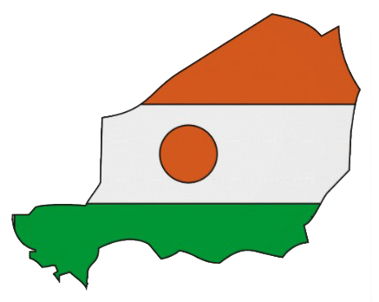
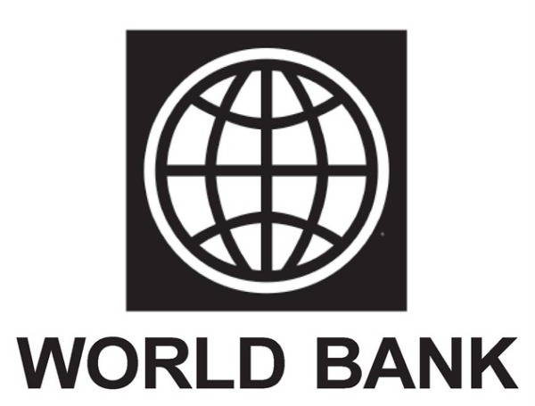
BRIEF OVERVIEW OF NIGER’S ECONOMY
Figures of Niger’s Economy
Underdevelopment and interventions of International institutions in Niger

Slide 4
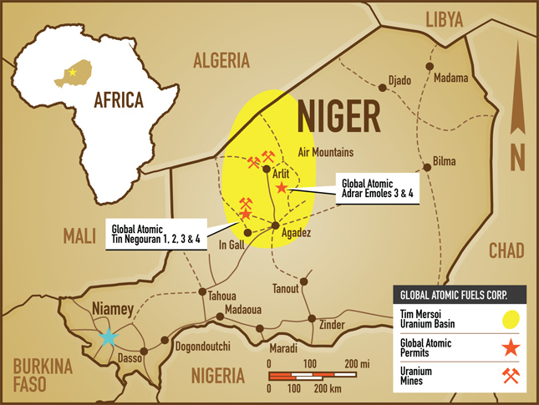
Figures of Niger’s Economy
Niger is a landlocked, Sub-Saharan nation, whose economy centers on subsistence crops, livestock, and some of the world's largest uranium deposits.

Slide 5
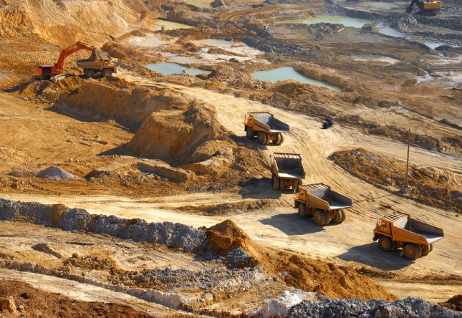
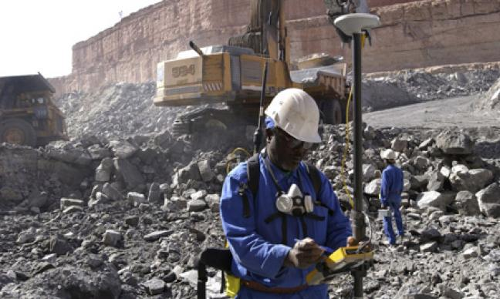
Figures of Niger’s Economy

Slide 6
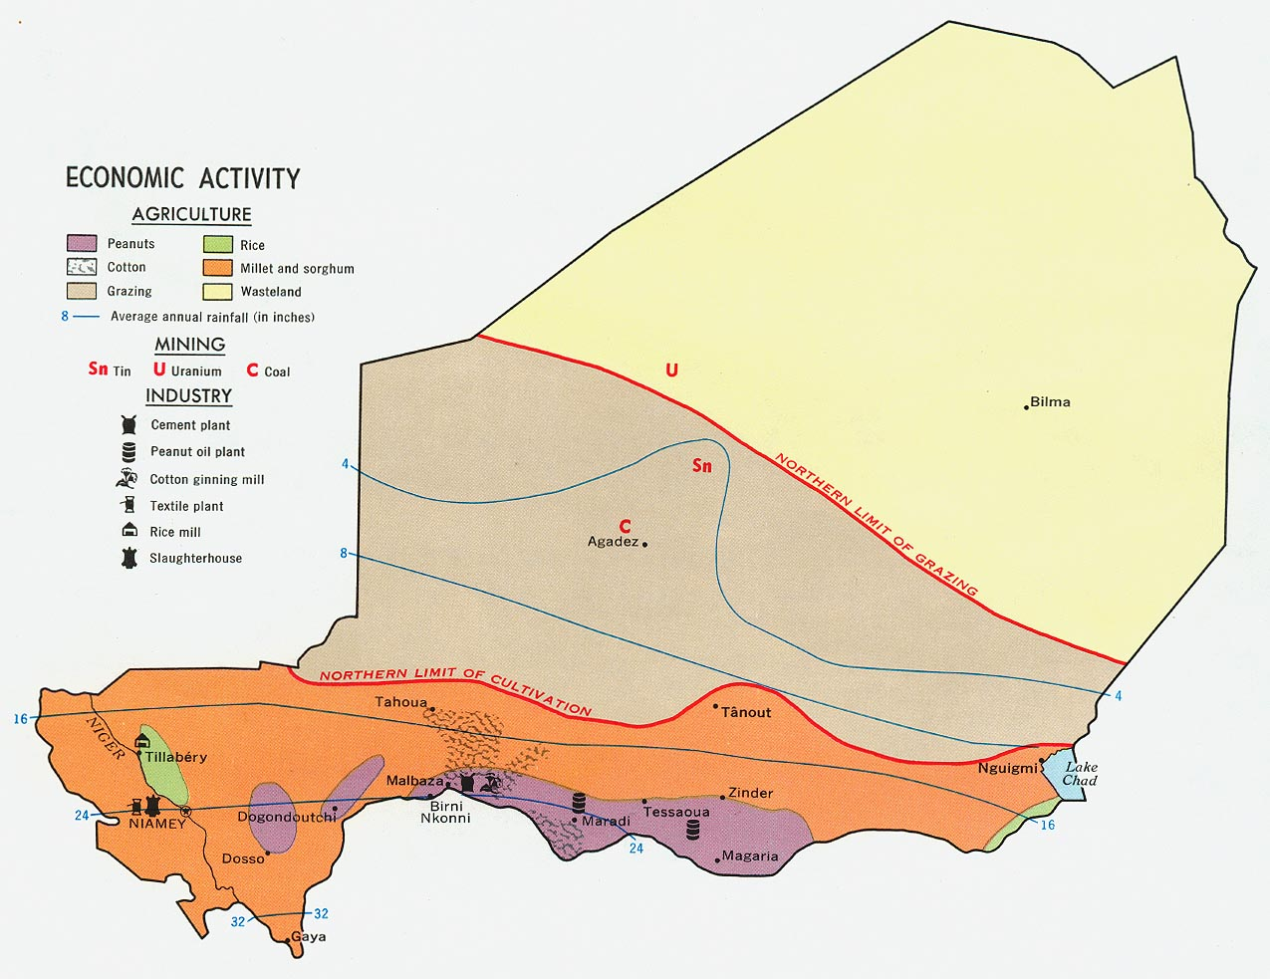

Slide 7
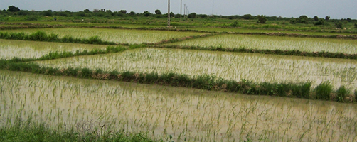
Figures of Niger’s Economy
Agriculture contributes about 40% of GDP and provides livelihood for about 90% of the population.
Agriculture products are: cowpeas, cotton, peanuts, millet, sorghum, cassava (manioc), rice; cattle, sheep, goats, camels, donkeys, horses, poultry.

Slide 8
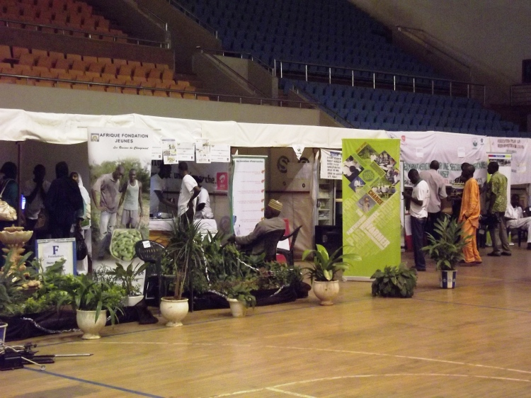
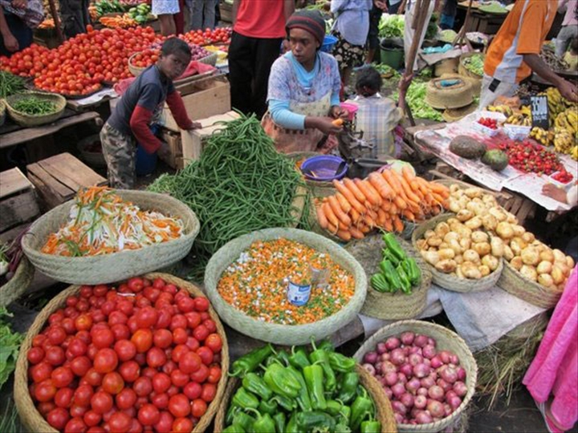
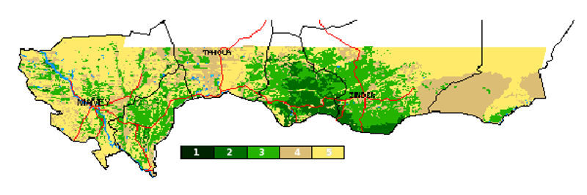
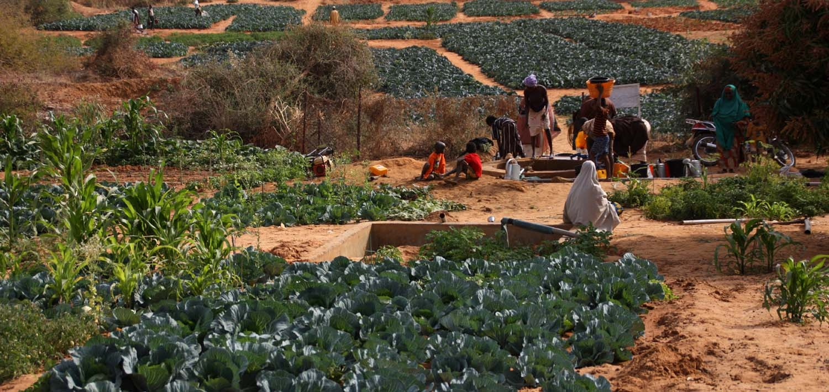

Slide 9
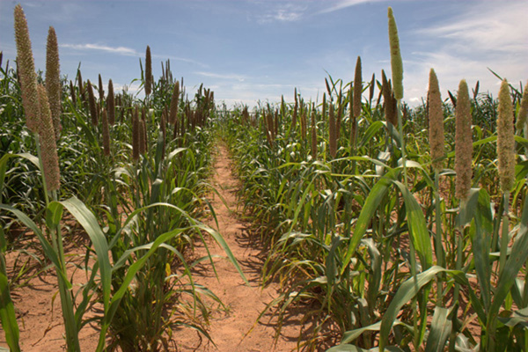
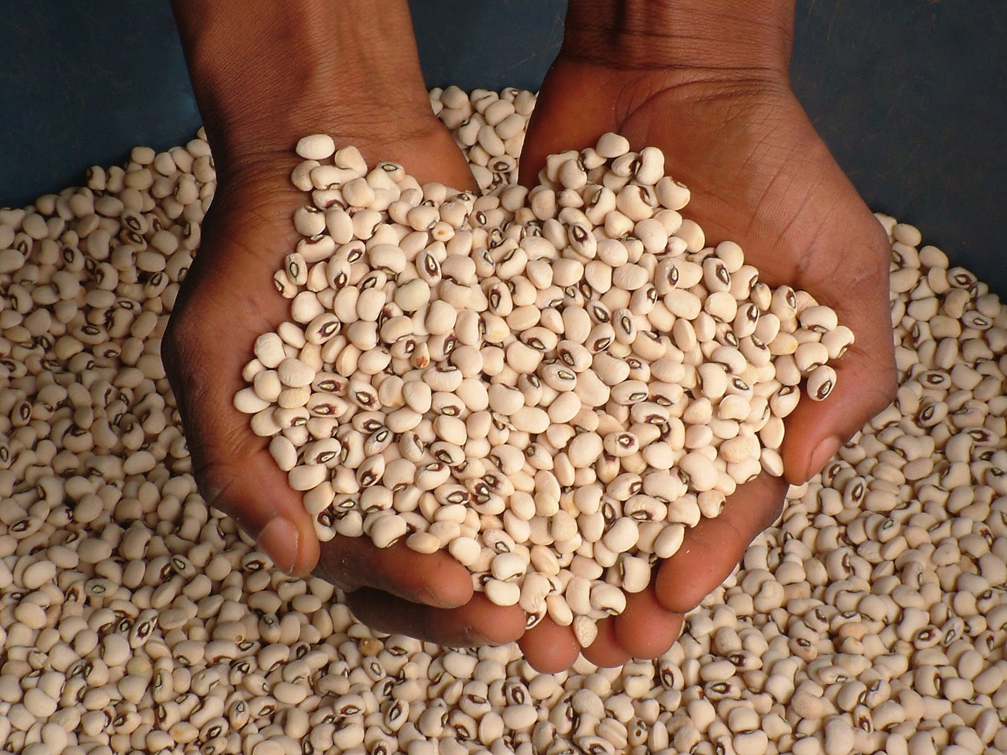
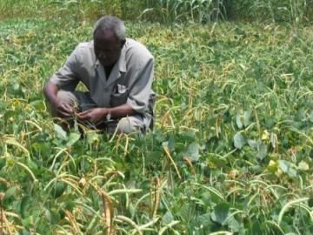
millet
Haricot Beans
Maize

Slide 10
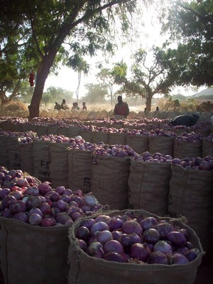
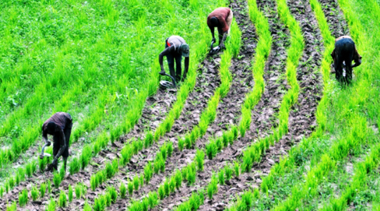
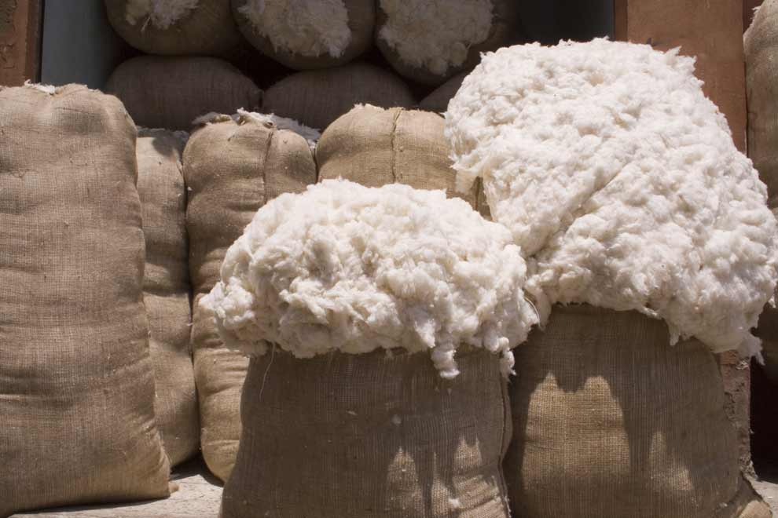
Rice (Oryza glaberrima)
Onion
Coton

Slide 11
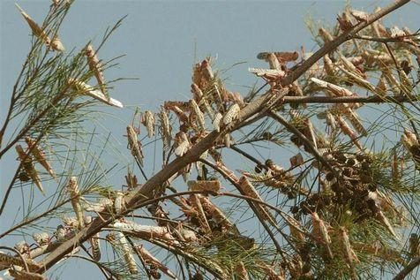
Figures of Niger’s Economy
The pilgrim locusts constitute the greatest threat to Nigerien agriculture.

Slide 12
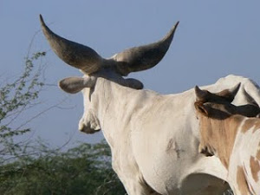
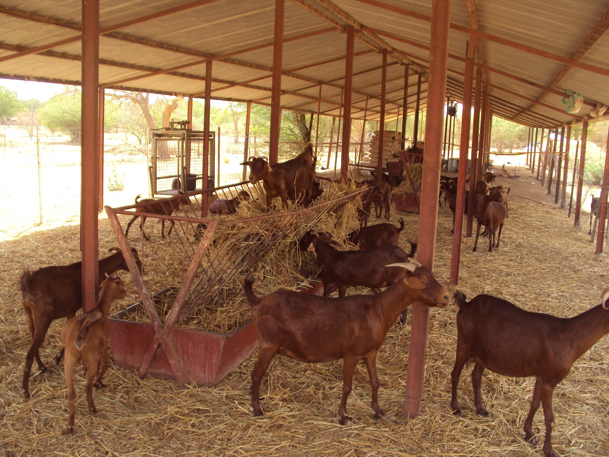
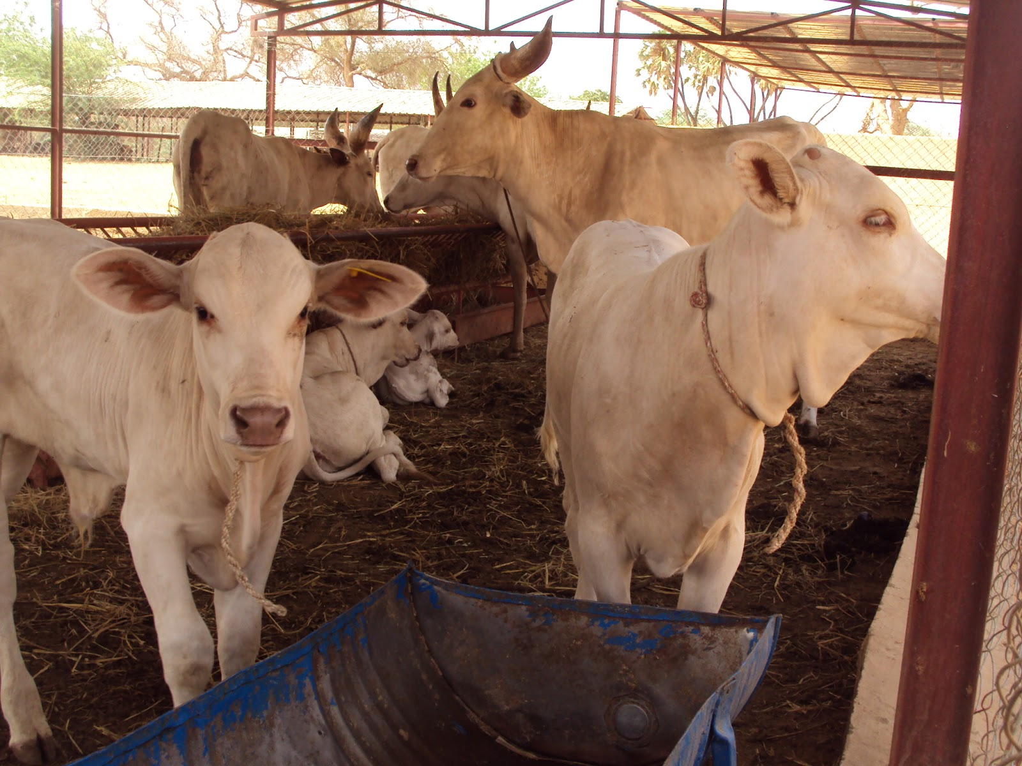
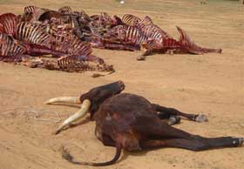
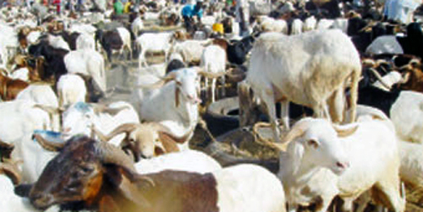
Figures of Niger’s Economy
Livestock is constitute with:
bovine animal
caprine animal
camels

Slide 13
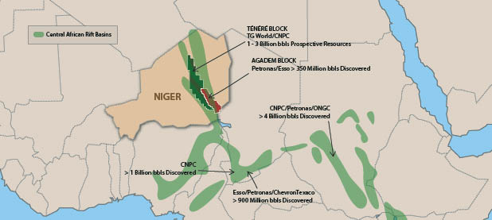
Figures of Niger’s Economy
Niger also has sizable reserves of oil, and oil production, refining, and exports are expected to grow significantly between 2011 and 2016.

Slide 14
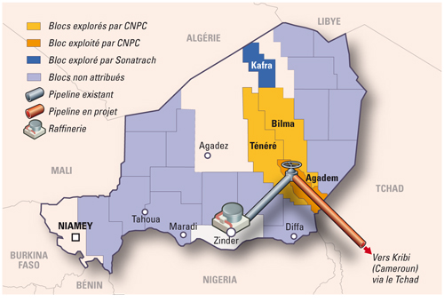
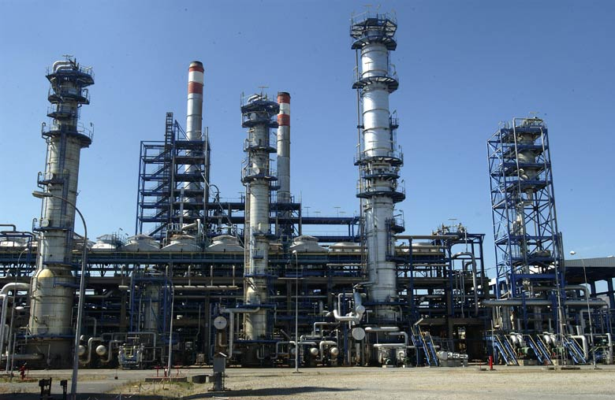
Niger’s Oil

Slide 15
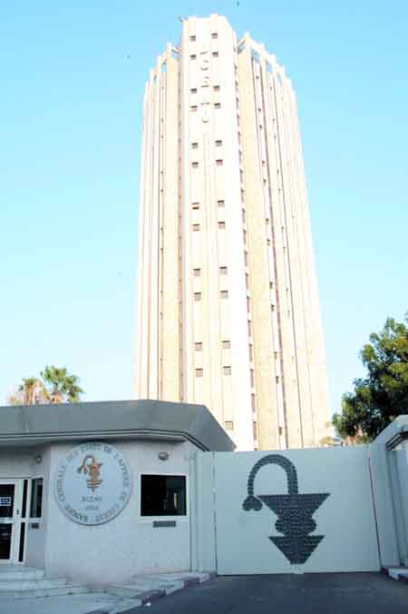
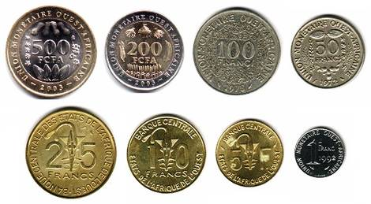
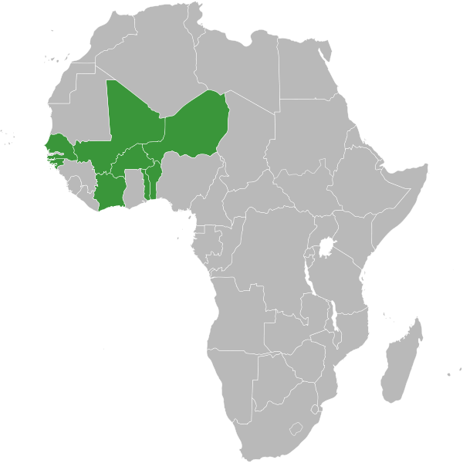
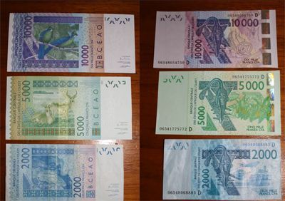
Figures of Niger’s Economy
Niger shares a common currency, the CFA franc, and a common central bank, the Central Bank of West African States (BCEAO), with seven other members of the West African Monetary Union.

Slide 16
Figures of Niger’s Economy
GDP: Purchasing power parity: $13.98 billion (2013 est.)
Official exchange rate: $7.304 billion (2013 est.)
GDP - real growth rate: 6.2% (2013 est.)
11.2% (2012 est.);
GDP per capita: $800 (2012 est.)
Inflation rate (consumer prices): 0.5% (2012 est.); 2.9% (2011 est.)
Investment Rate: 34%
Current Account balance: -$1.628 billion (2012 est.); -$1.697 billion (2011 est.)

Slide 17
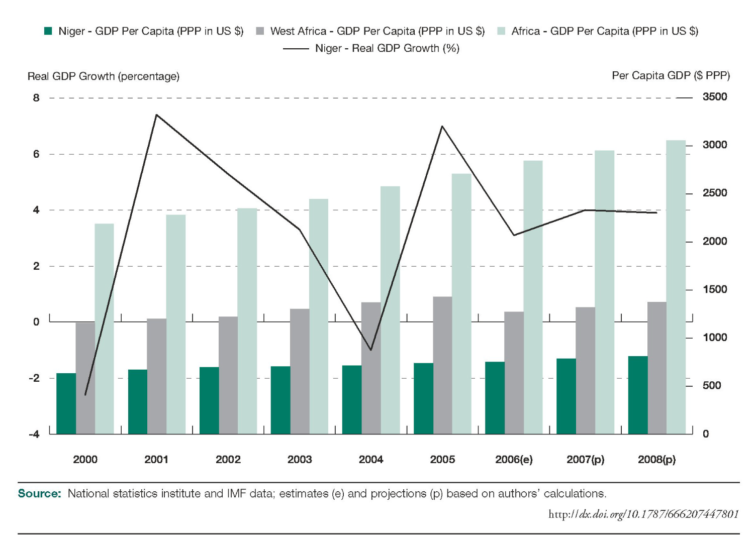
Situation of GDP per capita (PPP in US $) of Niger and comparison to West african’s GDP (2000-2008)

Slide 18
Figures of Niger’s Economy
Macroeconomic Indicators
 | 2011 | 2012(e) | 2013(p) | 2014(p)
Real GDP Growth | 2,1 | 13,1 | 5,5 | 6,5
Real GDP per capita growth | -1,4 | 9,6 | 2 | 3
CPI inflation | 2,9 | 3,9 | 1,8 | 1,4
Budget balance % GDP | -6,8 | -2,8 | -2 | -2,5
Current account balance % GDP | -22,7 | -22,7 | -21,5 | -17,8
Source: African Economic Outlook (Data from Domestic authorities); estimates (e) and prediction (p) based on authors' calculations.

Slide 19
Figures of Niger’s Economy

Slide 20
Figures of Niger’s Economy

Slide 21
Figures of Niger’s Economy

Slide 22
Underdevelopment and interventions of International institutions in Niger

Slide 23
NIGER, IMF AND WORLD BANK
Niger has a very low Human Developments Index and is one of very poor country in the World. This situation is due to the politic instabilities and geographic situation of the country.
Although IMF and World Bank financially assist Niger, their efforts are greatly insufficient regarding to the financial assistances they have provided to Asian and European countries just after the Second World War until today.
The fact that the insufficiency of financial assistances that IMF provided to African countries throughout the history Shows us that there is a serious marginalization inside the IMF.

Slide 24
NIGER AND IMF
In December 2005, Niger received 100% multilateral debt relief from the IMF, which translated into the forgiveness of approximately US$86 million in debts to the IMF, excluding the remaining assistance under HIPC (Highly Indebted Poor Countries)
The economy was hurt when the international community cut off non-humanitarian aid in response to TANDJA's moves to extend his term as president.
Nearly half of the government's budget is derived from foreign donor resources. Future growth may be sustained by exploitation of oil, gold, coal, and other mineral resources.
The government, however, has made efforts to secure a new three-year extended credit facility with the IMF following the one that completed in 2011.

Slide 25
NIGER AND WORLD BANK
The World Bank supports projects in water, rural development, HIV/AIDS, education, health, natural disaster management, and emergency food security.
But in Niger it mustly support the emergency food security.
According to Niger Statistics Institute’s report, the World Bank refuses to grant loans to Niger for education and infrastructures investments.
50% of loans are for food security, 25% Health and education and so on. But they can’t remember that the only problem that Niger has is the lack of investments.

Slide 26
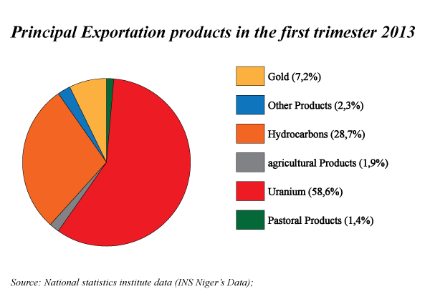
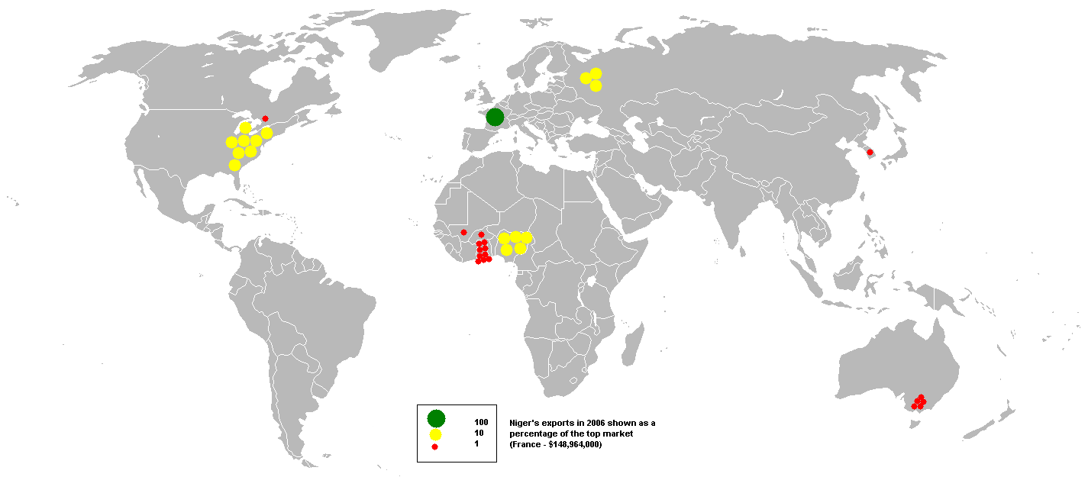
FOREIGN TRADE OF NIGER
Overview of Niger’s Foreign Trade (Exports/Imports)
Analysis of Balance of Payments

Slide 27
Overview of Niger’s Foreign Trade
A country’s Foreign Trade is characterized by importation and exportations of goods and services.
The Niger foreign trade is generally characterized by a deficit on the balance of payments

Slide 28
Overview of Niger’s Foreign Trade

Slide 29
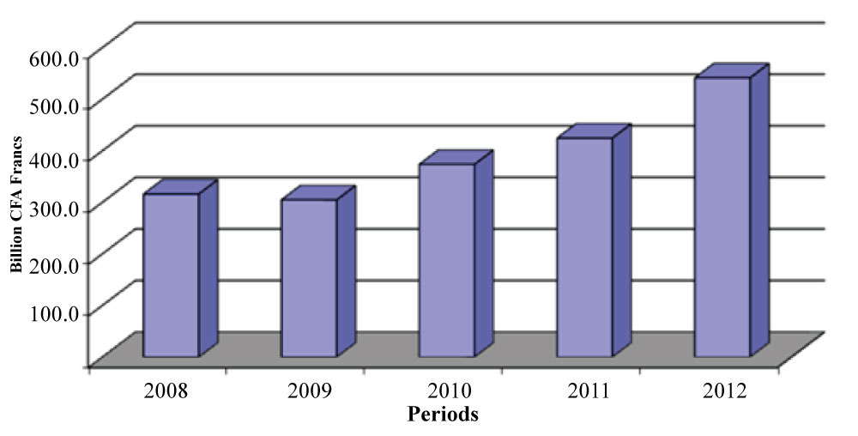
Exports
Evolution of Niger’s Exports 2008-2012 (in billion CFA Francs; 1$=461.6 FCFA in 2011)

Slide 30
Exports Structure of exports by product: predominance of uranium
Uranium | Hydrocarbons | Gold | Other Products | Agricultural Products | Pastoral Products
83 540 | 40 934 | 10 275 | 3 258 | 2 650 | 1 996
58,6% | 28.7% | 7.2% | 2.3% | 1.9% | 1.4%
(in billion CFA Francs; 1$=461.6 FCFA in 2011)

Slide 31
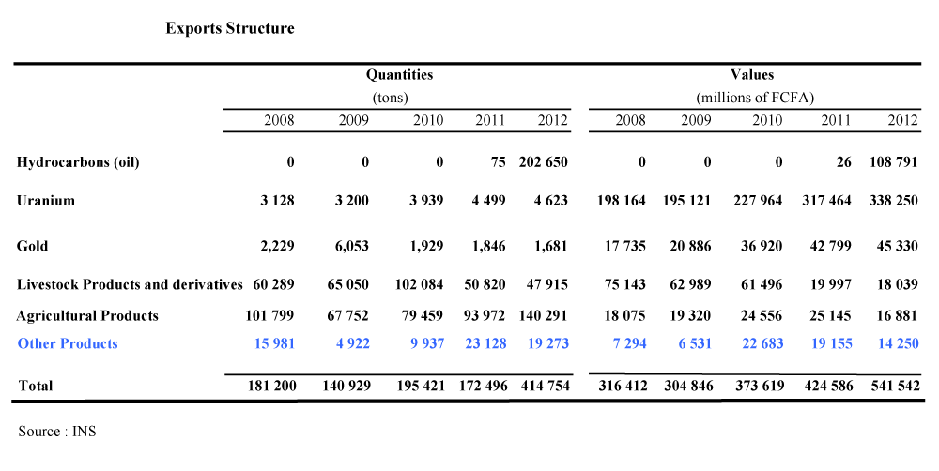
Exports Structure by products (values and Quantities) 2008-2012
(in million CFA Francs; 1$=461.6 FCFA in 2011)

Slide 32
Exports Structure by products (In percents) 2008-2012

Slide 33
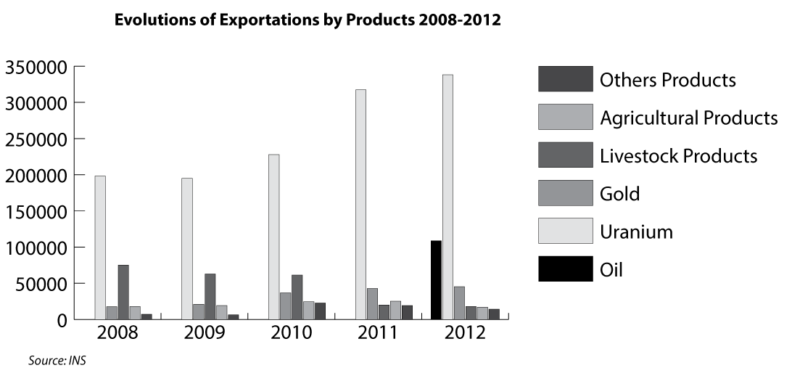
(in million CFA Francs; 1$=461.6 FCFA in 2011)

Slide 34
Geographical orientation of exports
Talking about the exports partners of Niger, according to the 2013 INS statistic report, we can say that today the five (5) principal partners of Niger are France (55.4 billions: 38.8%), Nigeria (23 billions: 16.2%), United States (28.5 billions: 20.0%), Swiss (10.4 billions: 7.3%), Burkina Faso (22.7 billions: 15.9%). They represent 98.5% of the total value of exportations.
Year over year, the top 5 export destinations of Niger are France with 49.7%, Switzerland 12.6%, Spain 12.4%, Nigeria 9.9% and 4.7% Mali. These countries were the top 5 customers of Niger and hosted 89.3% of export value.

Slide 35
Exports Map of Niger

Slide 36
Exports by main destination continents

Slide 37
Imports
Imports show a preponderance of food purchases, attesting to the country’s lack of food self-sufficiency.
The country’s landlocked position results in very high transportation costs, which contribute to deepening the deficit in the balance of payments: in 2005, the latter reached 10.1 per cent of GDP, excluding official transfers, and 7.8 per cent, including these transfers.

Slide 38
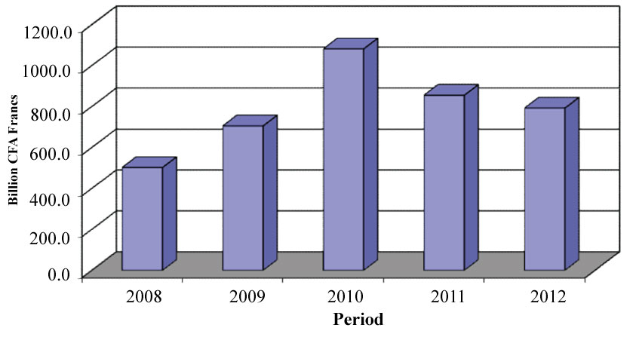
Evolution of imports of Niger during the period 2008 - 2012

Slide 39
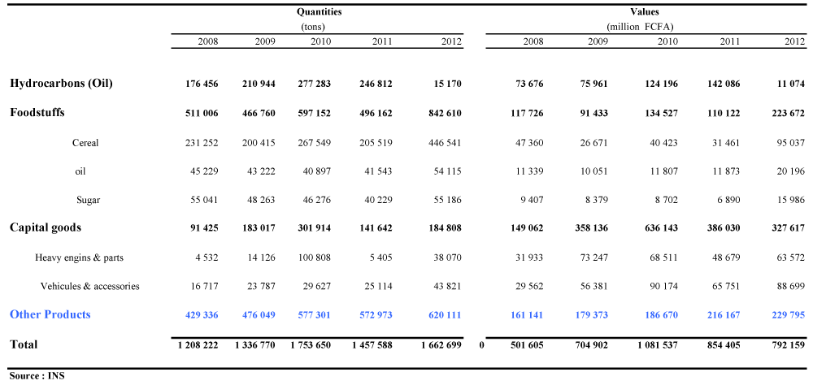
Structure of imports by product
Rice (19.1 billion or 8.9%), freight transport vehicles (10.0 billion or 4.7%), cement (10.3 billion or 4.8%), drugs (7.3 billion or 3.4%) and passenger vehicles (7.9 billion or 3.7%) are the main products of imports during the first quarter of 2013 .

Slide 41
Geographical orientation of imports
According to the origin, the main suppliers of Niger are China (174.9 billion or 22.1%), France (100.3 billion or 12.7%).
These two countries account for 34.8% of the value of total supply of Niger in 2012.
The rank of the first supplier occupied by China is explained by the strong involvement of this country in the mineral exploration and extraction in Niger.
In 2011, these two countries, with 27.7% and 12.8% respectively accounted for 40.5% of the total value of the national supply.

Slide 42
Imports (CIF) by Continent (million CFA Francs)

Slide 43
Geographical orientation of imports
In the first quarter of 2013, Asia consolidated its position as the leading supplier of Niger. With 108.5 billion, the continent provides 50.5% of total supplies of Niger in value against 51.1% in the previous quarter.
Africa with 22.5% (48.3 billion) occupies the second place while his rank was third with 40.2 billion (18.8%) in the 4th quarter 2012.
Europe, with 42.0 billion contributes to 19.6% (against 22.8% previously). This makes Europe the 3rd largest supplier of Niger.
These three continents contributed to 92.6% (against 92.7% the previous quarter) for domestic supply in the 1st quarter 2013. In annual change, the share of top 3 suppliers in continental level came out at 93.2%.

Slide 44
Geographical orientation of imports
In terms of economic unions, the EU leads with 185.6 billion FCFA (23.4%), followed by ECOWAS (Economic Community of West African States) with 158.0 billion FCFA (20.0%).
Imports of WAEMU (West African Economic and Monetary Union), with 95.2 billion FCFA of purchases, accounted for 12.0% of total acquisitions. Reported to ECOWAS, they represent 60.3%.

Slide 45
Analysis of Balance of Payments
The balance of payments is a statistical statement that records all economic and financial flows between residents of a country and non-residents in a specified period.
It is, therefore, an indispensable tool of decision support for authorities.

Slide 46
Analysis of Balance of Payments
Like the other member countries of the West African Economic and Monetary Union (WAEMU), the Niger’s balance of payments is established annually by the Central Bank of West African States (BCEAO) and validated by the National Committee of the balance of payments.
Estimates of this balance are regularly produced on the basis of the information available for the internal needs of the BCEAO and IMF missions.

Slide 47
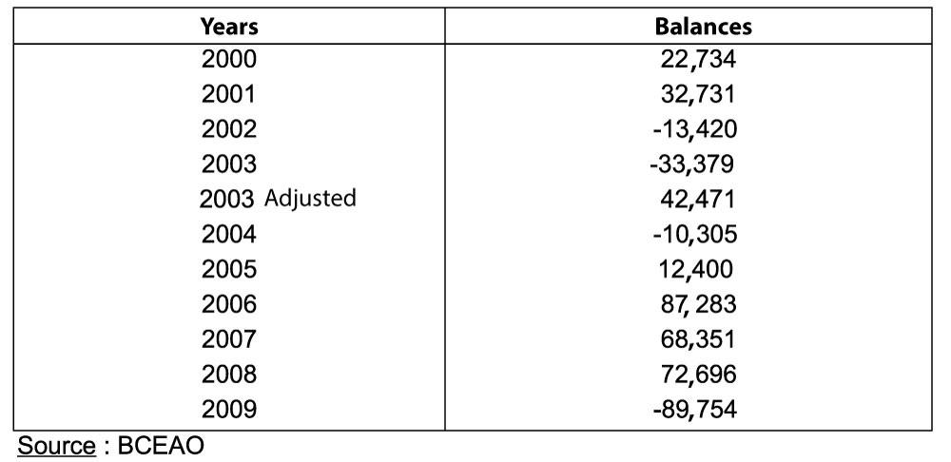
Evolution of the global balance of the balance of payments (Amounts in millions of FCFA)
The long-term evolution of the overall balance of the balance of payments of Niger remains highly dependent on internal exogenous shocks which the most recurrent are the agro-climatic conditions, but also external, related to the international environment, that it comes to the rising oil prices on the international market or external financial supports.

Slide 48
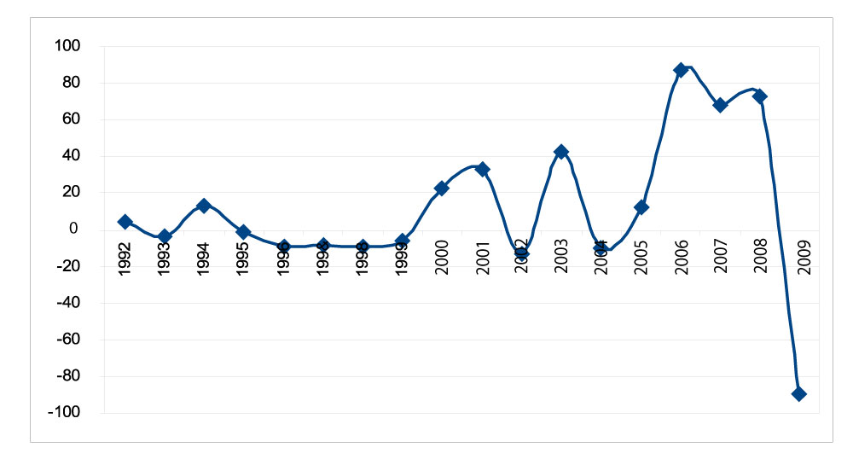
Evolution of the global balance of the balance of payments of Niger between 1992 and 2009

Slide 49
Analysis of Balance of Payments
Niger’s trade deficit widened again in 2012, increasing by 25 billion FCFA to 473 billion FCFA, despite the buoyancy of exports, boosted by sales of uranium and the country’s first refined petroleum products.
Exports were up 15.0%, representing 22.1% of GDP. Imports, meanwhile, grew by 14.8%, representing 35.8% of GDP.
The current account has a structural deficit and deteriorated in 2012. The deficit grew to 795 billion FCFA, or 22.7% of GDP, from 684 billion FCFA in 2011.
One of the main causes of this deterioration was the import of capital goods for major extraction investment projects.

Slide 50
Analysis of Balance of Payments
Furthermore, food imports almost doubled and imports of other consumer goods also increased. Foreign direct investment (FDI) – mainly Chinese and French investment in the mining and oil sectors – has remained high over the past three years, making the deficits sustainable.
Total FDI was 499 billion FCFA in 2011 and 402 billion FCFA in 2012. The current account balance should improve drastically in 2013.
Imports of the main refined petroleum products will fall dramatically, while exports should get into their stride after a slow start to 2012.
Meanwhile, in early 2012 the IMF approved a new three-year economic programme under the Extended Credit Facility that will further strengthen medium-term macroeconomic stability.

Slide 51
Current Account (percentage of GDP)
Source: African Economic Outlook

Slide 52
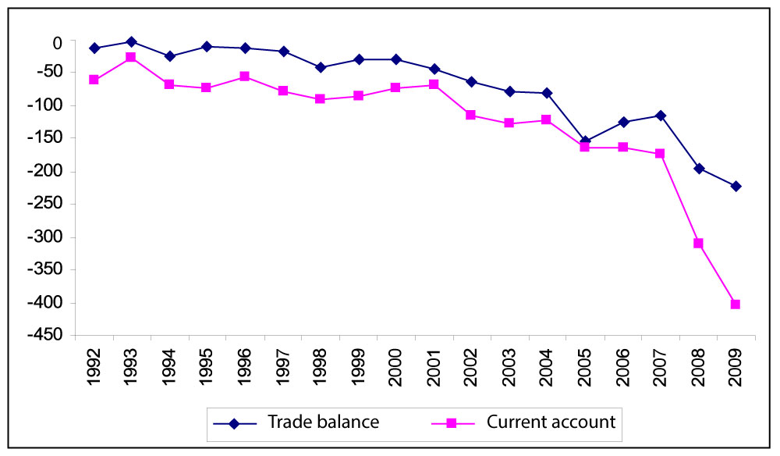
Comparative evolution of the trade balance and current accountentre 1992 et 2009 between 1992 and 2009

Slide 53
Analysis of Balance of Payments
Niger’s trade balance is structurally in deficit, owing not only to the low price and volume of exported products, but also to the import of capital goods, petroleum and food products.
The flows associated with imports and linked to the big projects in the oil and uranium sectors have increased tenfold since 2007, attaining 11% of GDP in 20093.
Labour and capital income, along with current transfers, are not enough to fill the trade gap, thus resulting in an external current account deficit that has almost tripled, up from 8.2% of GDP to 23.7% between 2007 and 2009.
However, the external current account deficit was covered by capital inflows from official development assistance and foreign direct investments (FDI).
These flows enabled the country to accumulate exchange reserves equivalent to 2.5 months of import as at end 2009.

Slide 54
Analysis of Balance of Payments
The balance of payments of Niger showed a debit balance out with credit balances observed since 2005.
This reversal results from the degradation of current account, partially offset by the improvement in the capital account and financial transaction.
The current account deficit increased from 311,718,000 to 621,322,000 under the effect of a simultaneous deterioration in the balance of goods, services and income well above the improvement of current transfers.
This large deficit was financed by an important contribution of public capital and foreign private.
In Indeed, the capital account and financial transactions stood at 538.631 million against 390,139,000 in 2008.
Overall, the balance of the balance of payments has emerged Deficit 89,754,000 in 2009 against a surplus of 72,696,000 in 2008.

Slide 55
REGIONAL AND BILATERAL RELATIONS
The position of Niger’s Foreign Trade in Africa
The position of Niger’s Foreign Trade in the World
The Relationship between Niger and Regional and International (Trade) Organizations
Agreements With Regional and International (trade) Organizations

Slide 56
The trade of Niger is officially administrated by the Department of Trade and Private Sector Promotion. But there are also the Nigerien Association of Export Promotion (ANIPEX) and the Chamber of Commerce, Industry and Crafts of Niger (CCIAN) which play a very crucial role in the blossoming of foreign trade in Niger by forging bilateral relationships with regional and international organizations.

Slide 57
The position of Niger’s Foreign Trade in Africa
The position of Niger Trade in Africa is more focused in West Africa where it (Niger) is one of the biggest suppliers in mining and Agricultural goods.
Despite this Niger remain with a low economic profile in the region. Its big trade partner in West Africa is Nigeria: its neighbour country.
In the table below we can see that the external current account of Niger as percentage of GDP is a little bit low compared to that of Western African countries.
It is also low compared to that of the whole of Africa.

Slide 58
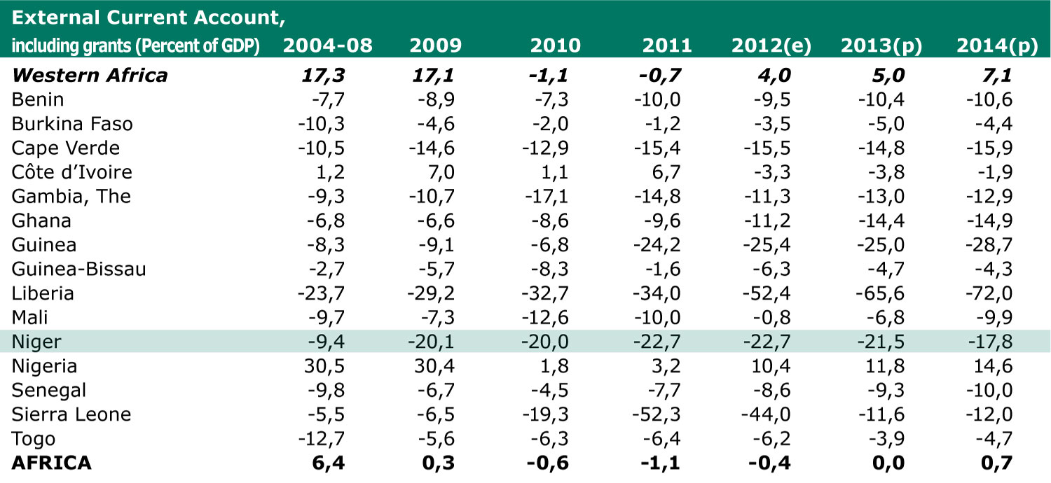
External Current Account (percent of GDP)
e: estimates; p: projections Source: African Economic Outlook

Slide 59
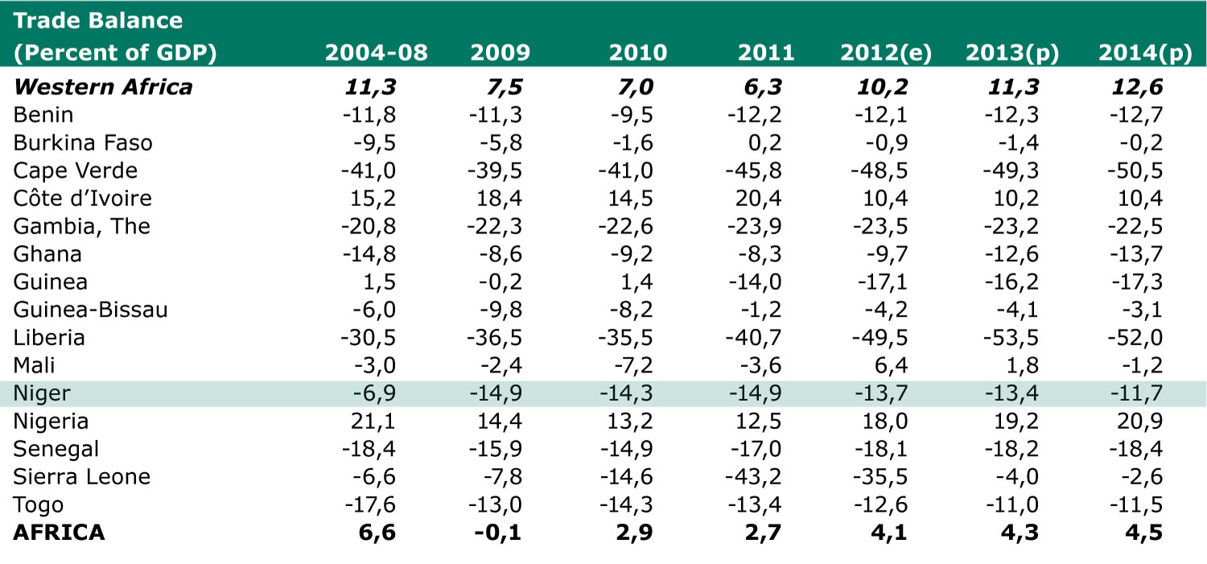
Trade Balance (percent of GDP)
e: estimates; p: projections Source: African Economic Outlook

Slide 60
The position of Niger’s Foreign Trade in the World
During the ten passed years, the Niger’s foreign trade was focused on uranium and capital goods.
Today Niger took places in the list of Oil producers in the world and this situation gives to it the opportunities to meet new markets in the world.
According to WTO’s data, the Niger trade level is very under the international trade level.

Slide 61
The Relationship between Niger and Regional and International (Trade) Organizations
The Ministry of Trade and Private Sector Promotion (or, Ministry of Commerce) is the structure responsible for trade policy adopted by the Government of Niger.
The Ministry of Commerce is responsible for international trade negotiations and the implementation of policies relating to foreign trade.
The Minister of Commerce represents the State at ministerial meetings of the WTO and for meetings that affect trade, ministerial meetings of UEMOA, the Economic Community of West African States (ECOWAS) and of the ACP-EU partnership.

Slide 62
The Relationship between Niger and Regional and International (Trade) Organizations
Ancient contracting party to GATT 1947, the Niger is a member of the WTO since 13 December 1996.
It is recognized as "Least Developed Countries (LDCs)" within the WTO. Niger is not a member of any plurilateral agreement, but it could become an observer to the plurilateral WTO Agreement on Government Procurement.
It should be noted that the Niger supported the application by the WAEMU Commission to become an observer to the WTO.
The WAEMU member States create progressively a common commercial policy, which they project to put in the WTO.

Slide 63
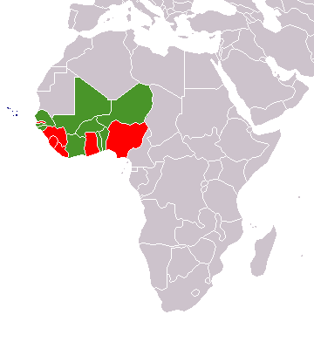
WAEMU and ECOWAS member States map
Legend:
Red and Green: ECOWAS members Green: WAEMU members (zone CFA franc)
Source: Wikipedia

Slide 64
The Relationship between Niger and Regional and International (Trade) Organizations
With the visit of Turkish Prime Minister Recep Tayyip Erdoğan, Niger enter in new partnership with new other partner in Asia.
Trade relationships between Niger and Turkey start with the participation of Niger’s businessmen to the International Fair of Istanbul in 2012.
After the Prime Minister Recep Tayyip Erdoğan’s official visit, the two country signed several economic agreements in general and commercial agreements particularly.

Slide 65
Agreements With Regional and International (trade) Organizations
Niger has concluded over the years many bilateral trade agreements and economic cooperation.
For the most, agreements with other WTO members provide the regime of MFN.
More favourable conditions - free admission - are covered by the agreement with Tunisia.
However, bilateral trade agreements of Niger and the other members of WAEMU will gradually be replaced by agreements between UEMOA and third countries.

Slide 66
Agreements With Regional and International (trade) Organizations
Niger is a member of the Agreement Establishing the Multilateral Investment Guarantee Agency (MIGA) since June 11, 2002, and the International Centre for Settlement of Investment Disputes (ICSID) since 14 December 1966.

Slide 67
Agreements With Regional and International (trade) Organizations
Regarding regional integration, Niger has signed and ratified all protocols and agreements drawn up by the main regional integration and cooperation bodies, including WAEMU and ECOWAS.
Niger participates actively in discussions on Economic Partnership Agreements (EPAs) and on introducing a five-band common external tariff (CET) for ECOWAS.
The challenge for the customs authorities is to combat fraudulent imports of goods, especially from Benin and across the porous 1 500 km border between Niger and Nigeria.

Slide 68
Agreements With Regional and International (trade) Organizations
Niger is one of the ACP countries with which the EU signed the Partnership Agreement.
This agreement entered into force on 1 March 2000 and was signed on 23 June 2000 in Cotonou, Benin.
It replaces the Lomé Convention, in effect since 1975, the fourth extension expired at the end February 2000.

Slide 69
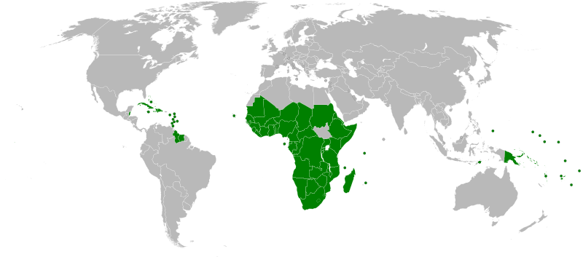
African Caribbean and Pacific Group of States member nations map
Source: Wikipedia

Slide 70
Agreements With Regional and International (trade) Organizations
The trade provisions are one of the mechanisms of cooperation between the ACP countries and the EU.
The latter admits as franchises, the industrial products and the processed agricultural products originating in 70 ACP countries on the basis of non-reciprocity (the Agreement on Trade, Development and Cooperation applies to South Africa).
Seeing the structure of trade with the EU, constituted mainly by uranium, Niger benefited primarily from the operation of the STABEX mechanism on peanuts, however small-scale

Slide 71
THANK YOU FOR YOUR ATTENTION
I’m waiting for your questions
www.moutari.weebly.com

